Slide 1
ACCUS Smart City Demo Platform: pollution, electricity, traffic

Slide 2
Principles and Motivation
Properties of smart cities
Smart Cities, I. Celino, S. Kotoulas (eds.), IEEE Internet Computing, November/December 2013: - effectively process networked city information - information to authorities, business, citizens, optimizing energy and water production or consumption, trafic management, public safety, emergency response - multifaceted and cross-domain challenges, inherently disciplinary - reason on spatial, temporal and contextual aspects of data - life-cycle of data, intergrating heterogenous sources - ubiquitous, pervasive, AmI, agents, AI - IBM Smarter Planet initiative, Siemens Sustainable Cities, Oracle IT platform City services, Microsoft CityNext platform

Slide 3
ACCUS project info
ACCUS - Adaptive Cooperative Control in Urban (sub)Systems
better sustainable management and to engage synergies in order to improve citizens’ quality of life
GA number ARTEMIS-2012-1/8/2013
Started: 1st June 2013, planned end: 31st May 2016
Just started second half of the project
Planned platform implementation: June 2015
Demonstration: running platform on a demo
Platform on jBoss, virtual entities(up to 10.000), web services (3-20)

Slide 4
ACCUS platform advantages
Easy integration of cross domain applications
Acces to urban subsystem
Simplified communication between components (applications, platform, subsystems, etc.)
Acces to general and specific functionalities in the ICP
Unified management of city subsystems
Automatic self-management in case of exceptional events

Slide 5
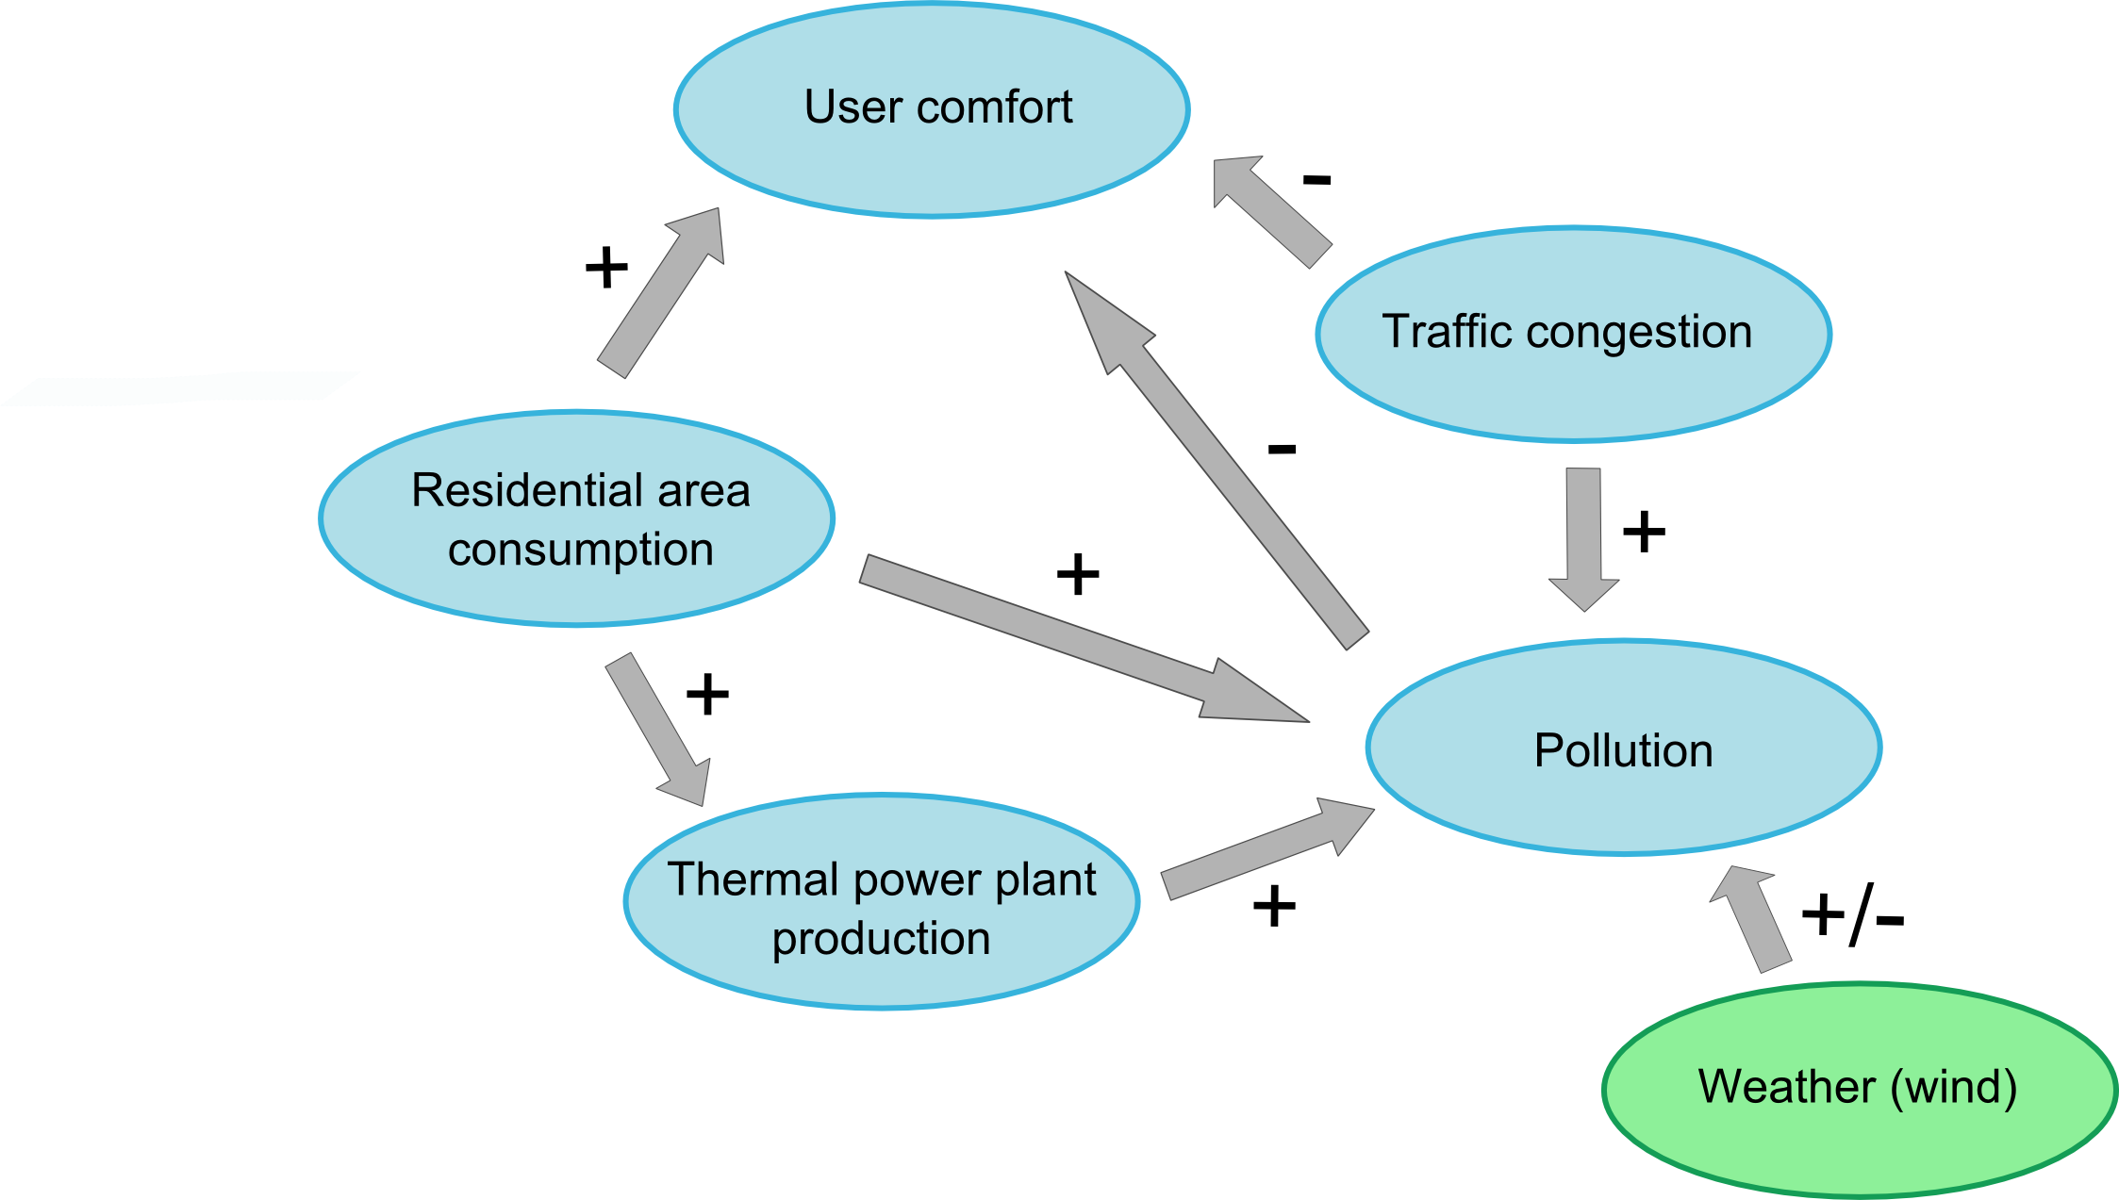
Concepts corelations
Notes:
Weather +/-
Weather druga barva
Weather (wind)

Slide 6
Problem Description
Pollution warning is triggered
The core reasoning agent starts decreasing electricity consumption and traffic: - household electricity consumption
- thermoelectrical plant production
- traffic through most polluted city areas
Human supervisor observes activities and interferes if necessary

Slide 7
ACCUS Apps
Subsystems
Subsystems
API Lib
Adaptors
Adaptors
API Lib
API Lib
API
ICP Mind
ACCUS config
ICP Extension Services
ICP Core
ICP Backbone
Case specific reasoner
(e.g. pollution causes reasoner)
Case specific optimiser
(e.g. traffic optimiser)
Semantic Mapping
Info Broker & coordination
Negotiation Engine
Control coordination
Reasoning Engine
Object Detection and Tracking
(e.g. Crowd following)
Complex Event Detectors (e.g. disaster discovery)
Complex Event Detection Engine
Optimization Engine
Negotiators
(e.g. Collaborating houses)
Ontologies
Semantics Enriched Database
Agent Framework
Critical Process Execution Engine
ACCUS software architecture
ICP
CSDB
Self / Subsystem Monitoring
Authentication & Authorisation
ICP Reconfiguration
Registry
ICP Framework
Database servers
Workflow Management
Policy Management
Management
Application Server
Message Broker
Access & Identity
Service Repository
Service Bus
Service broker
Security
API Management
OS
HW

Slide 8
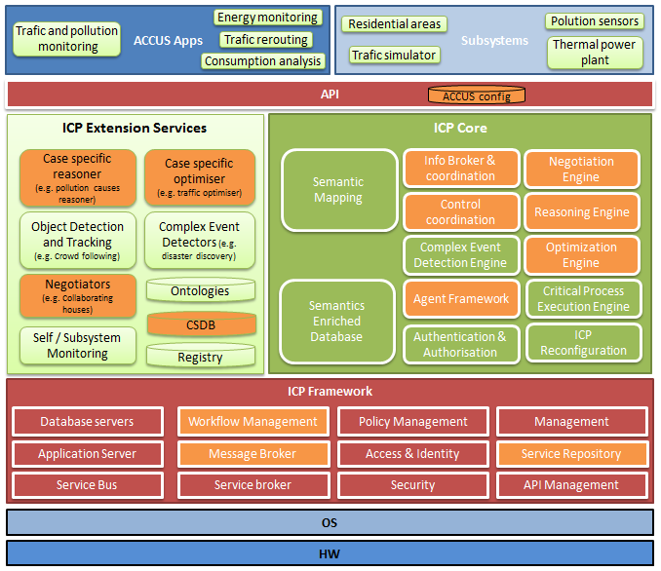
ACCUS architecture
Notes:
Senzor pri city pollution sensor subsystem
Pri tovarni thermal power plant
Levo application: in pri slikah brez

Slide 9
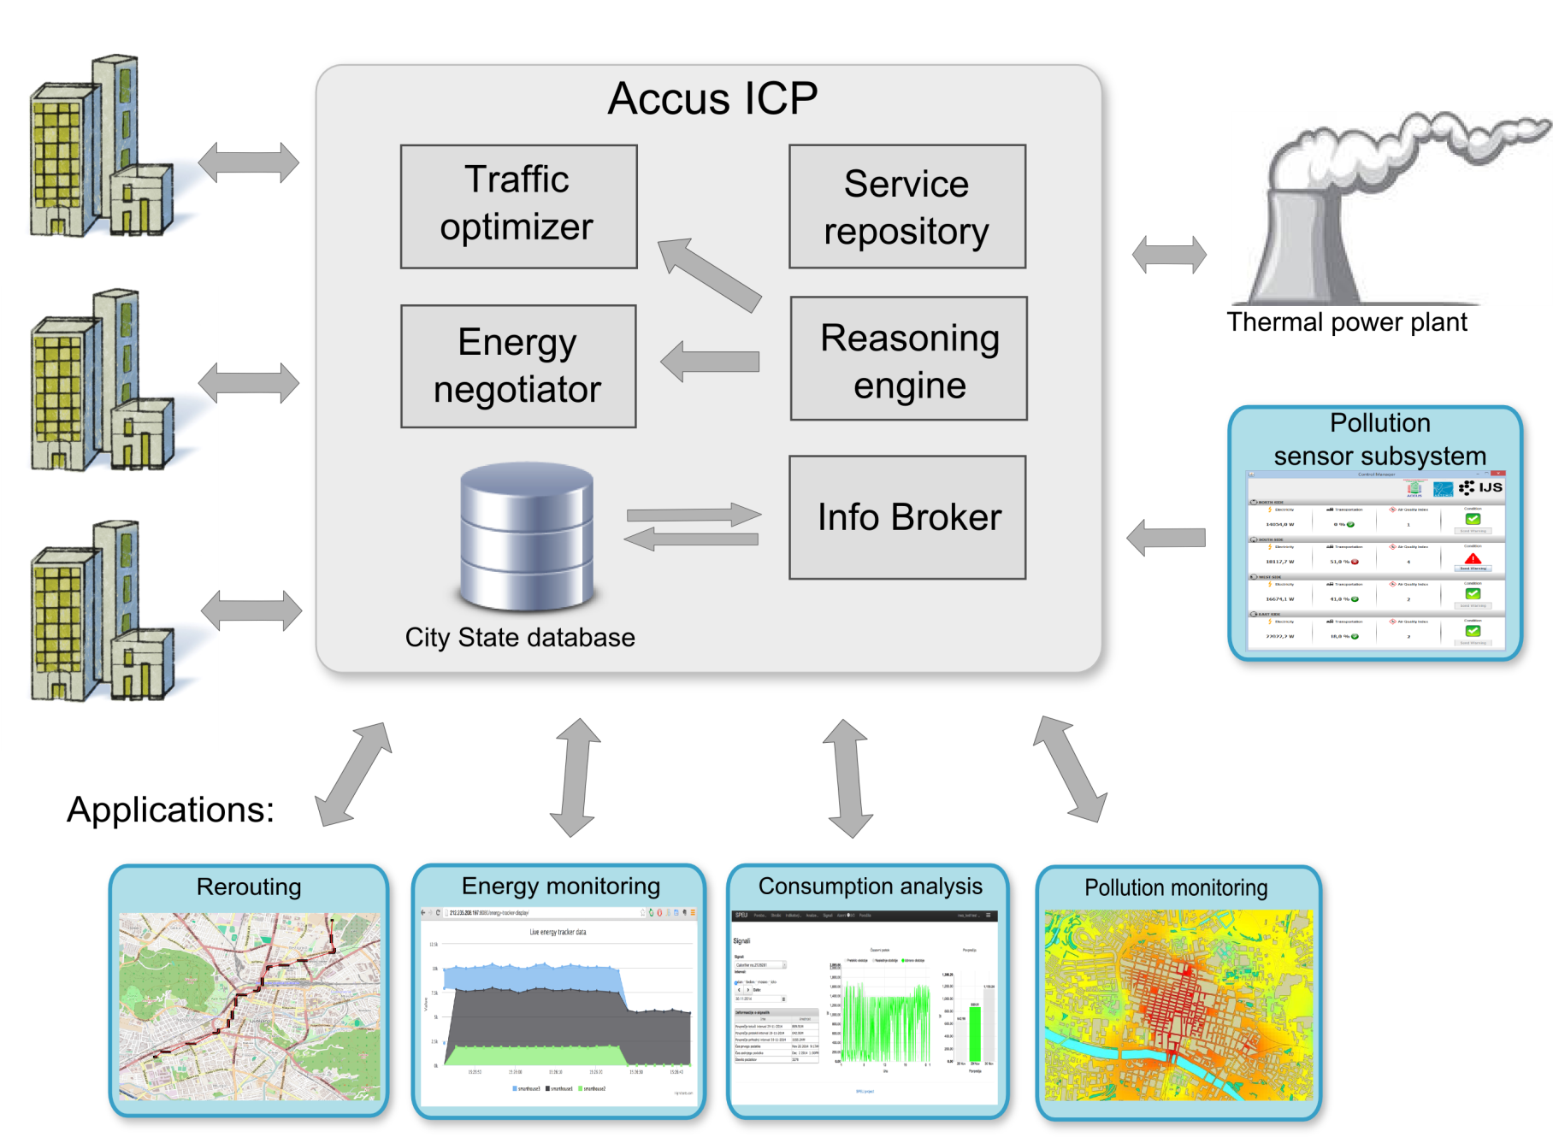
Demo architecture
Notes:
Senzor pri city pollution sensor subsystem
Pri tovarni thermal power plant
Levo application: in pri slikah brez

Slide 10
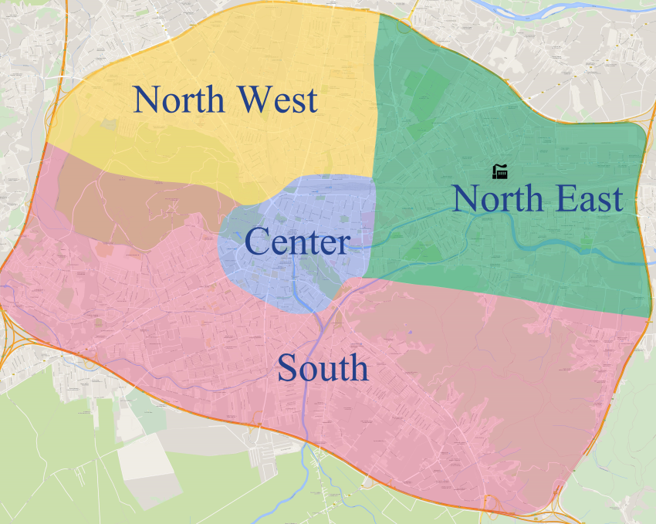
Video - normal situation and alarm
Four disctricts of a city (four rows):
several 10 residential areas represented with smart agents
First column: Electricity consumption
Second column: Traffic congestion (%)
Third column: Air quality index (1-10)
Alarm is triggered due to decreased air quality, caused by a combination of weather, energy production and traffic congestion.

Slide 11
Pollution detection and alarm

Slide 12
Energy tracker application – normal situation and increase

Slide 13
Traffic monitoring

Slide 14
Smart city self management/control
Smart city reasoner receives the alarm from the pollution monitoring application, inferres the needed actions and distributes the tasks to the ICP serviceses:
Energy negotiatior should decrease district residential area consumption
As a consequence the power plant controller decreases power production
Traffic optimizer reroutes traffic to other districts
Smart city reasoner supervises the execution and effects of the tasks and inffers additional actions.

Slide 15
Smart city self-management
Reasoning engine
Energy negotiator
Traffic optimizer
Smart grid
Thermal power plant
North East district
South district
North West district
Center district
Notes:
Districts in dodati novo (done)

Slide 16
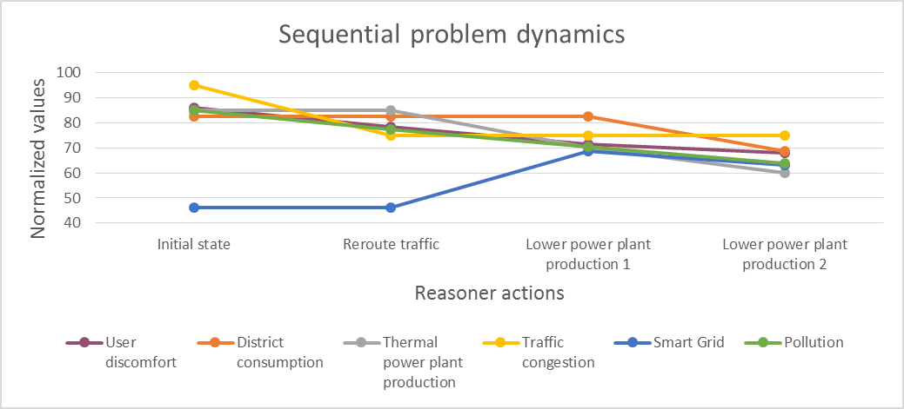
Demonstration of smart city self-management 4 sequential steps to show influence of submodules
Reasoner actions | User discomfort | District consumption | Thermal power plant production | Traffic congestion | Smart Grid | Pollution
Initial state | 86 | 82 | 85 | 95 | 46 | 85
Reroute traffic | 79 | 82 | 85 | 75 | 46 | 78
Lower power plant production 1 | 72 | 82 | 70 | 75 | 69 | 71
Lower power plant production 2 | 68 | 69 | 60 | 75 | 63 | 64

Slide 17
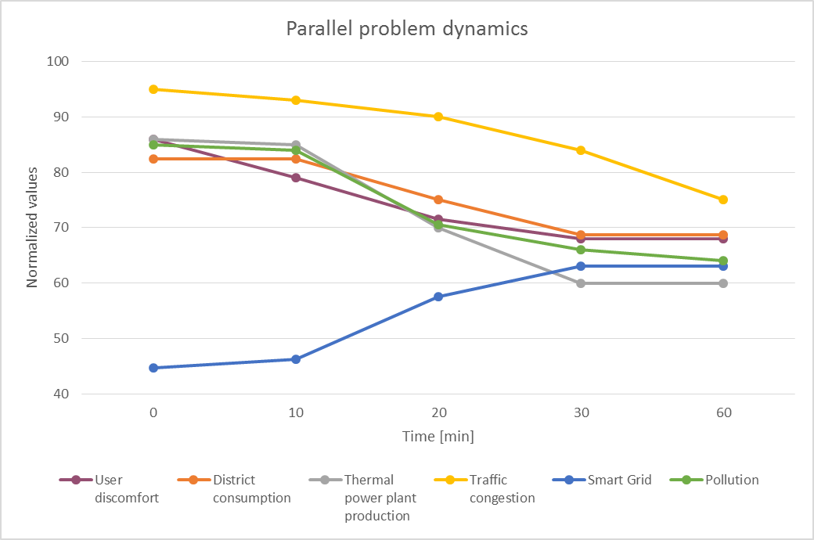
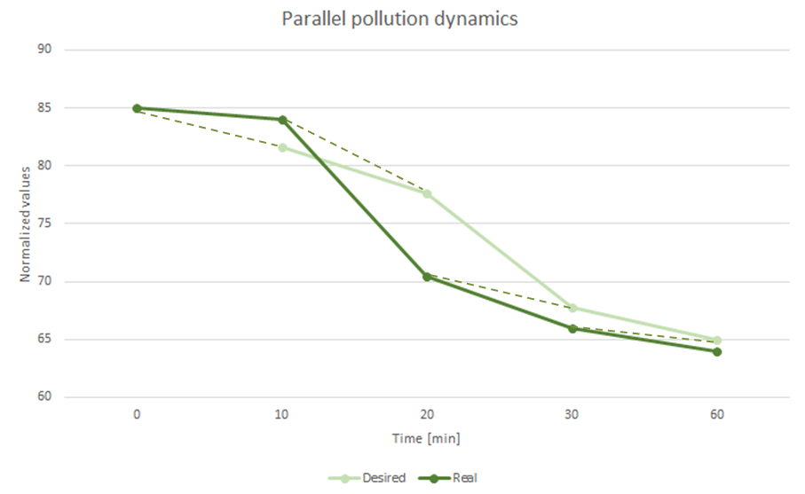
Smart city self-management parallel tasks in time: lowering thermal power plant production and traffic congestion, negotiating district consumption for best user comfort
Time [min] | User discomfort |  | District consumption |  | Thermal power plant production |  | Traffic congestion |  | Smart Grid |  | Pollution
 | Real | Desired | Real | Desired | Real | Desired | Real | Desired | Real | Desired | Real | Desired
0 | 86 | 70 | 82 | 70 | 86 | 60 | 95 | 75 | 45 | 65 | 85 | 65
10 | 79 | 83 | 82 | 80 | 85 | 82 | 93 | 92 | 46 | 48 | 84 | 82
20 | 72 | 76 | 75 | 78 | 70 | 77 | 90 | 87 | 58 | 52 | 71 | 78
30 | 68 | 71 | 69 | 73 | 60 | 65 | 84 | 83 | 63 | 61 | 66 | 68
60 | 68 | 70 | 69 | 70 | 60 | 60 | 75 | 75 | 63 | 65 | 64 | 65

Slide 18
Pollution monitor resolution

Slide 19
Lowering consumption

Slide 20
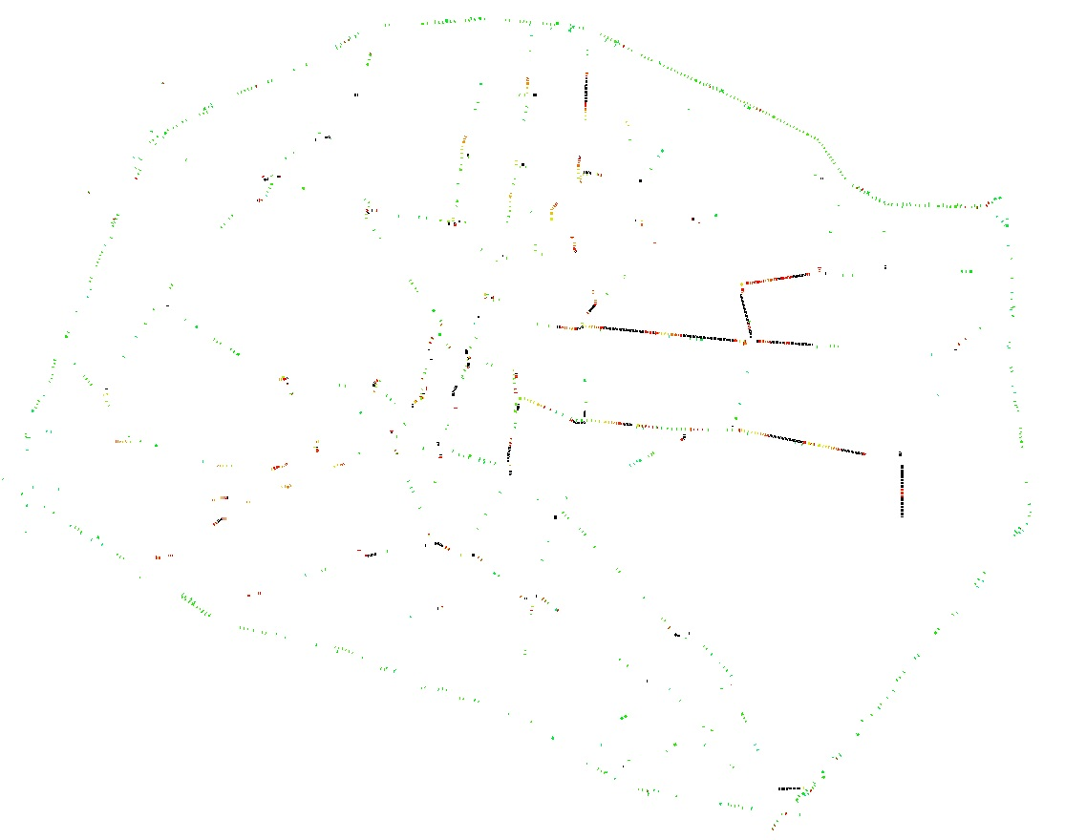
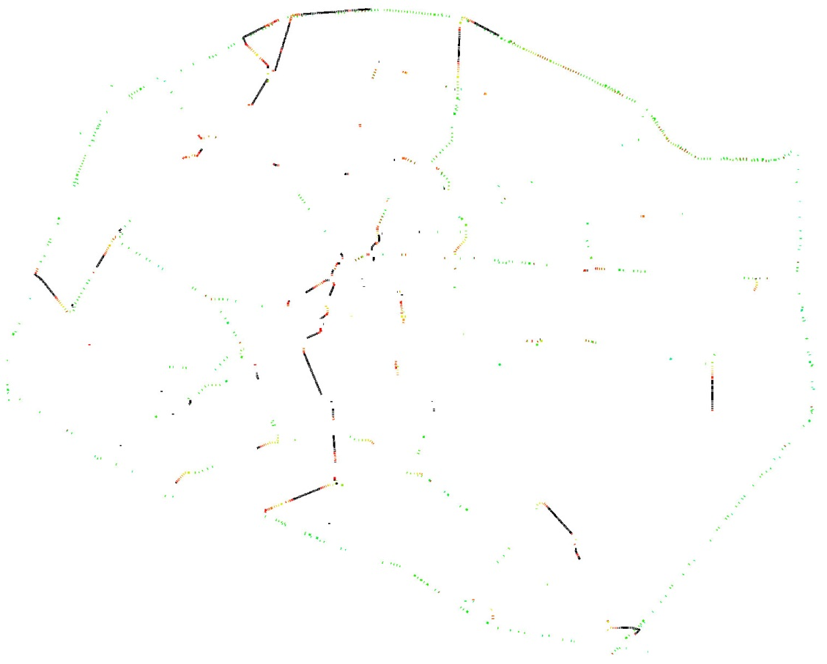
Traffic rerouting
Traffic congestion before
Traffic congestion after

